Slide 1
Chapter 12: Mass-Storage Systems
May, 2024

Slide 2
Chapter 12: Mass-Storage Systems
Overview of Mass Storage Structure
Disk Structure
Disk Management
Disk Scheduling
RAID Structure

Slide 3
Objectives
To describe the physical structure of secondary storage devices and its effects on the uses of the devices
To explain the performance characteristics of mass-storage devices
To evaluate disk scheduling algorithms
To discuss operating-system services provided for mass storage, including RAID

Slide 4
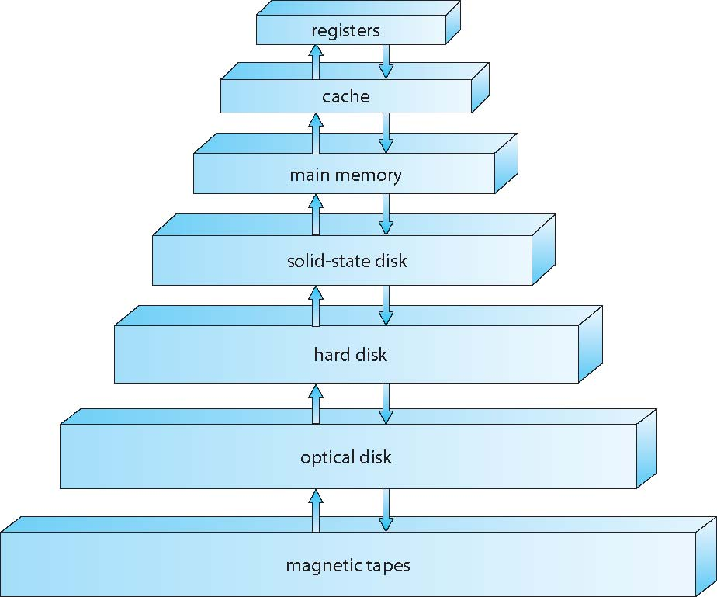
Storage Hierarchy

Slide 5
Hard Disk

Slide 6
Moving-head Disk Mechanism
Notes:
Track：磁道（圆形）
Sector：扇区
Cylinder：柱面
Platter：盘片
Spindle：转轴
Disk arm：磁臂

Slide 7
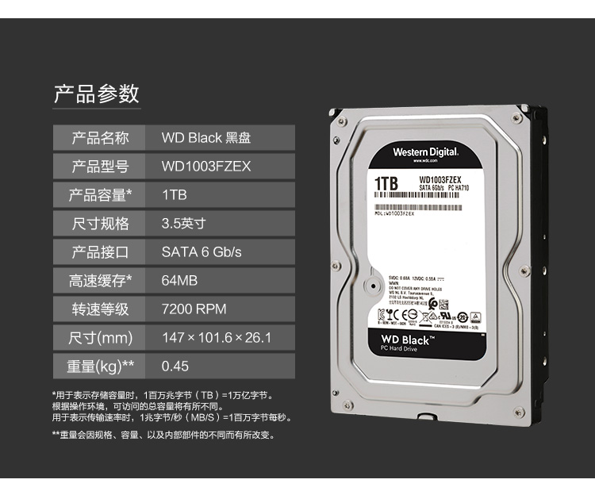
Modern Commercial
Notes:
559 Yuan

Slide 8
Performance of HDD
Magnetic disks provide bulk of secondary storage of modern computers
Size:
Capacity:
Rotational speed:
Interface: IDE, SATA, m2, …
Cache:

Slide 9
Transfer Rate
Transfer rate is rate at which data flow between drive and computer
Transfer Rate
theoretical – 6Gb/sec
Effective Transfer Rate
real – 1Gb/sec

Slide 10
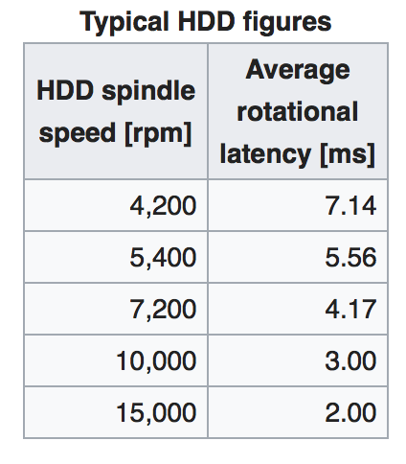
Rotational Speed
RPM：每分钟转数
Notes:
RPM：每分钟转数

Slide 11
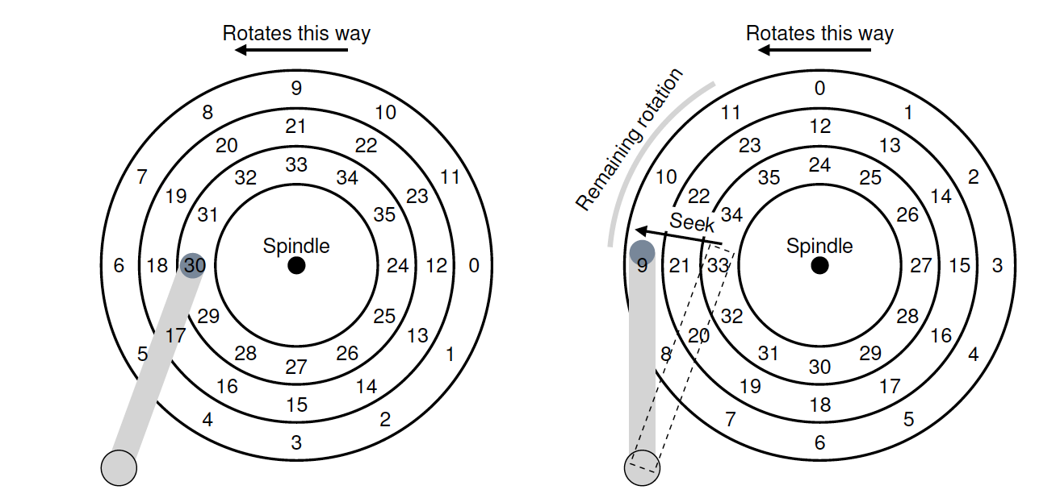
Seek Time（寻道时间）
Rotational latency
Seek time from 3ms to 12ms – 9ms common for desktop drives

Slide 12
Performance of HDD
Random access
time to move disk arm to desired cylinder (seek time)
and time for desired sector to rotate under the disk head (rotational latency)
Random access time = seek time + rotational latency
IOPS (input/output per second)
Sequential access

Slide 13
Average I/O Time
For example to transfer 128KB data on a 7200 RPM disk with a 5ms average seek time, 100MB/s transfer rate with
Average seek time: 5ms
Average rotational latency: 4.17ms
Data transfer: 128KB / 100MB/s = 1.25ms
IO time = data transfer + seek time + rotational latency

Slide 14
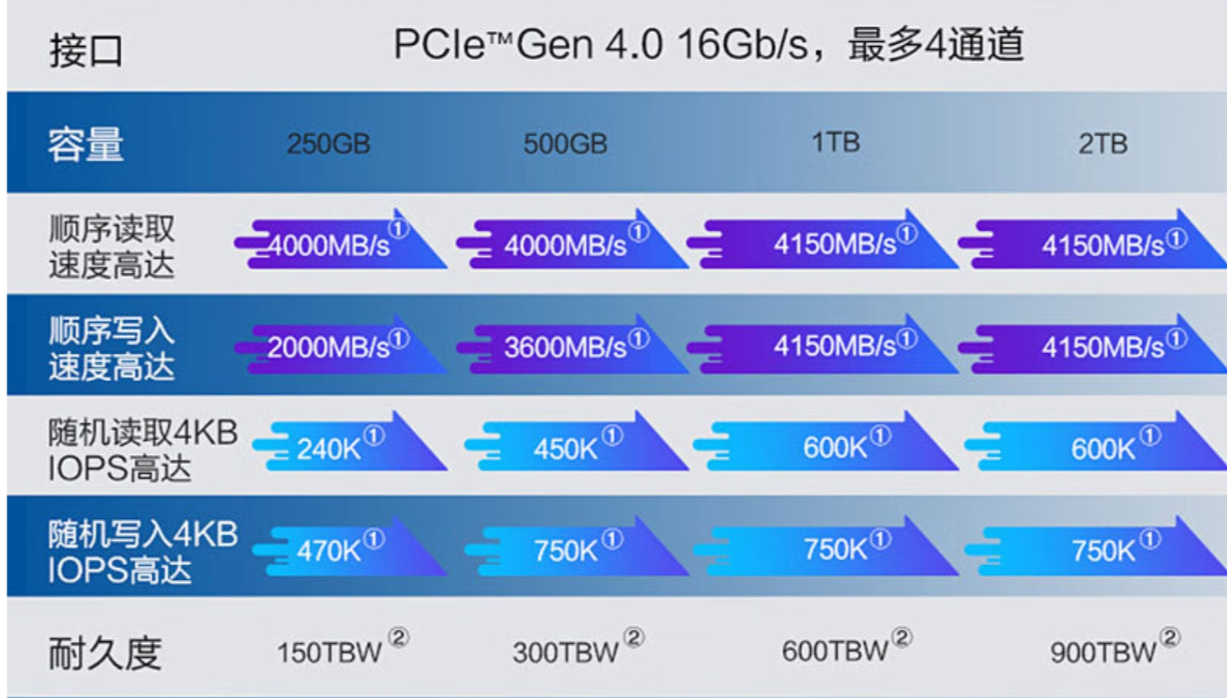
Performance of SSD
Notes:
569Yuan;
Tera bytes written? 1T擦写600次

Slide 15
Solid-State Disks
Nonvolatile（非易失性） memory used like a hard drive
Many technology variations
But much faster
No moving parts, so no seek time or rotational latency
Save energy
anticollision
More expensive per MB ??? [for high capacity]
Less capacity ??? [relatively high capacity]
Maybe have shorter life span
Erase before overwrite
Wear off
Data rescue
Notes:
399 yuan, zhitai

Slide 16
SSD Pages
Notes:
读写以page为基本单位，擦除以block为基本单位。导致修改数据时write amplification，即写放大。
https://card.weibo.com/article/m/show/id/2309404087694979387904
第一次写入SSD时，所有颗粒都是已擦除状态，数据能以页为最小单位进行写入（一般为4K）；
SSD的主控制器，使用逻辑（LBA）和物理（FTL）的映射系统来管理闪存；
当有新的数据写入需要替换旧的数据时，SSD主控会把新数据写入到另外空白空间（已擦除状态），然后更新逻辑LBA地址来指向新的物理FTL地址；旧的地址内容变为无效数据，如要写入需先擦除，擦除最小单位为块，一般为128~256个页；

Slide 17
Magnetic Tape（磁带）
Was early secondary-storage medium
Relatively permanent and holds large quantities of data
Access time slow
Random access ~1000 times slower than disk
Mainly used for backup, storage of infrequently-used data, transfer medium between systems

Slide 18
Disk Structure

Slide 19
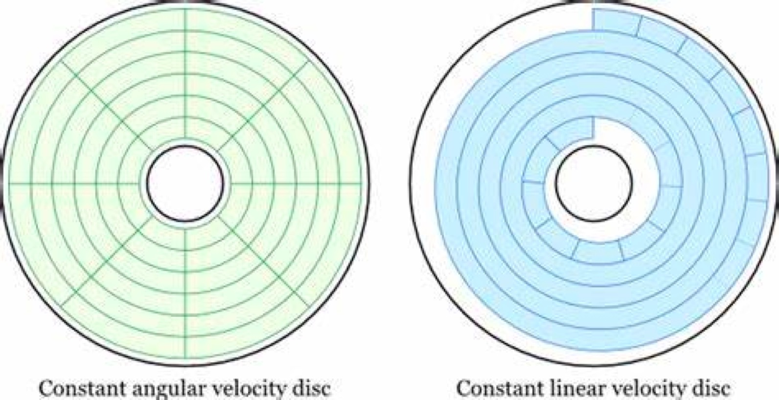
Sectors
Notes:
一个问题没有讲清楚：（CAV）传输速率内外圈一样不一样？？？
不再讲CLV，直接讲ZBR

Slide 20
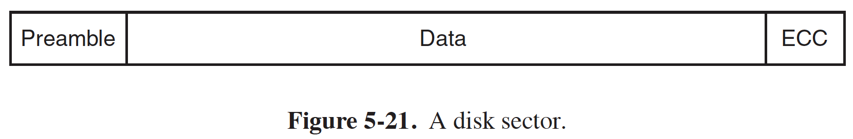
Sectors
Notes:
preamble里的数据？前导符是在对磁盘进行格式化的时候写上去的，它包括柱面数和扇区号，扇区大小以及类似的数据，此外还包含同步信息。

Slide 21
LBA Mapping
Disk drives are addressed as large 1-dimensional arrays of logical blocks
Logical block address (LBA)
Logical to physical mapping
The 1-dimensional array of logical blocks is mapped into the sectors of the disk sequentially
Sector 0 is the first sector of the first track on the outermost cylinder
Mapping proceeds in order through that track, then the rest of the tracks in that cylinder, and then through the rest of the cylinders from outermost to innermost
Notes:
Sector 0 是最外面柱面的第一个磁道的第一个扇区，映射顺序先按磁道内扇区顺序，再到柱面内磁道顺序，再按从外到内的柱面顺序
一个LB的大小：也就是一个sector的大小
以前的磁盘一个sector一般为512B，现在一般是4KB，SSD一个page也是4KB。
磁盘驱动器以一个LB（sector）作为最小单元

Slide 22
Logical block
一个LB的大小：也就是一个sector的大小
以前的磁盘一个sector一般为512B，现在一般是4KB，SSD一个page也是4KB。
磁盘驱动器以一个LB（sector）作为最小单元

Slide 23
Disk (HDD) Management
Low-level formatting, or physical formatting — Dividing a disk into sectors that the disk controller can read and write
Each sector can hold header information, plus data, plus error correction code (ECC)
Usually 512 bytes of data but can be selectable
To use a disk to hold files, the operating system still needs to record its own data structures on the disk
Partition（分区） the disk into one or more groups of cylinders, each treated as a logical disk（每个分区可以有自己的file system，被称为volume）
Logical formatting or “making a file system”

Slide 24
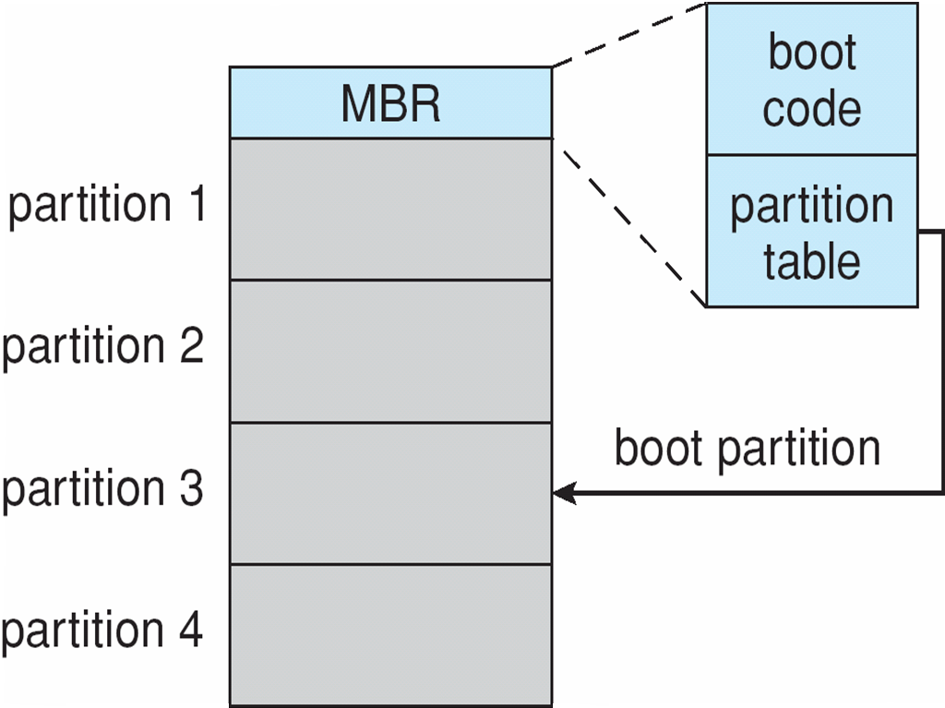
Disk (HDD) Management
Raw disk
High level formatting (cooked)
Low-level formatting
partition
High-level formatting
Install OS

Slide 25
Disk (HDD) Scheduling

Slide 26
Disk Scheduling (Cont.)
There are many sources of disk I/O request
Concurrent processes
I/O request includes input or output mode, disk address, memory address, number of sectors to transfer
OS maintains queue of requests, per disk or device（设备等待队列）
Idle disk can immediately work on I/O request, busy disk means work must queue
Optimization algorithms only make sense when a queue exists

Slide 27
Disk Scheduling
Request queue
E.g. elevator
Minimize total seek time
Seek time ≈ seek distance
Cylinder number
LBA
OS or hardware?
Notes:
磁盘调度：OS上移到应用程序；OS下移到存储设备
后面的调度算法我们先不考虑rotational latency（旋转磁盘），只考虑如何旋转磁臂在各个柱面之间流转

Slide 28
Disk Scheduling (Cont.)
Several algorithms exist to schedule the servicing of disk I/O requests
The analysis is true for one or many platters
We illustrate scheduling algorithms with a request queue (0-199, cylinders)
98, 183, 37, 122, 14, 124, 65, 67
Head pointer 53
Notes:
Linux的磁盘调度？算法？OS or 硬件？

Slide 29
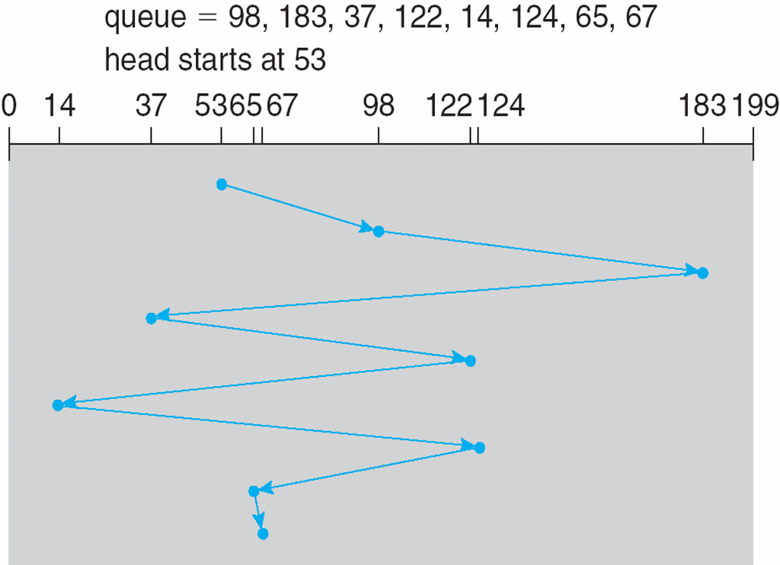
FCFS
Notes:
Illustration shows total head movement of 640 cylinders

Slide 30
SSTF
Shortest Seek Time First selects the request with the minimum seek time from the current head position
SSTF scheduling is a form of SJF scheduling;
may cause starvation of some requests
处理距离最短的
Notes:
Illustration shows total head movement of 236 cylinders

Slide 31
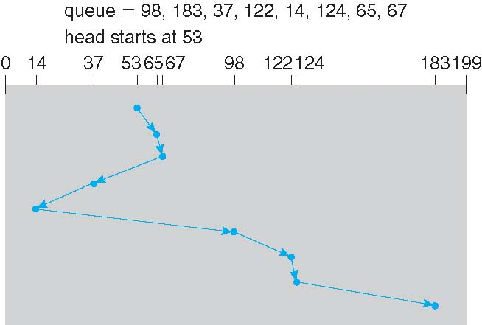
SSTF (Cont.)
Notes:
236

Slide 32
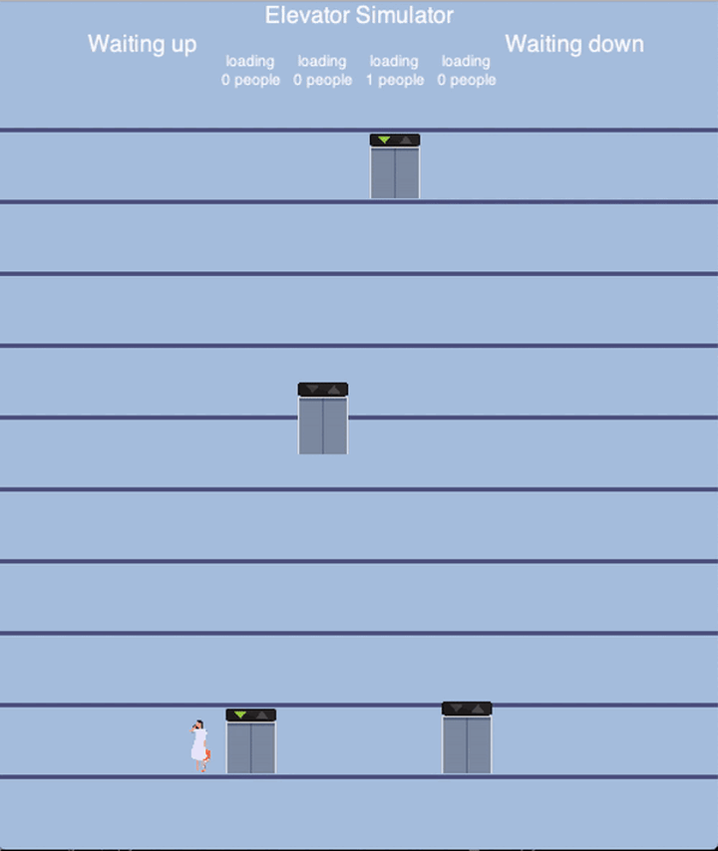
SCAN
The disk arm starts at one end of the disk, and moves toward the other end, servicing requests until it gets to the other end of the disk, where the head movement is reversed and servicing continues.
Moving direction
Elevator
Notes:
这个是普通SCAN，从磁盘的一端到另一端来回扫描

Slide 33
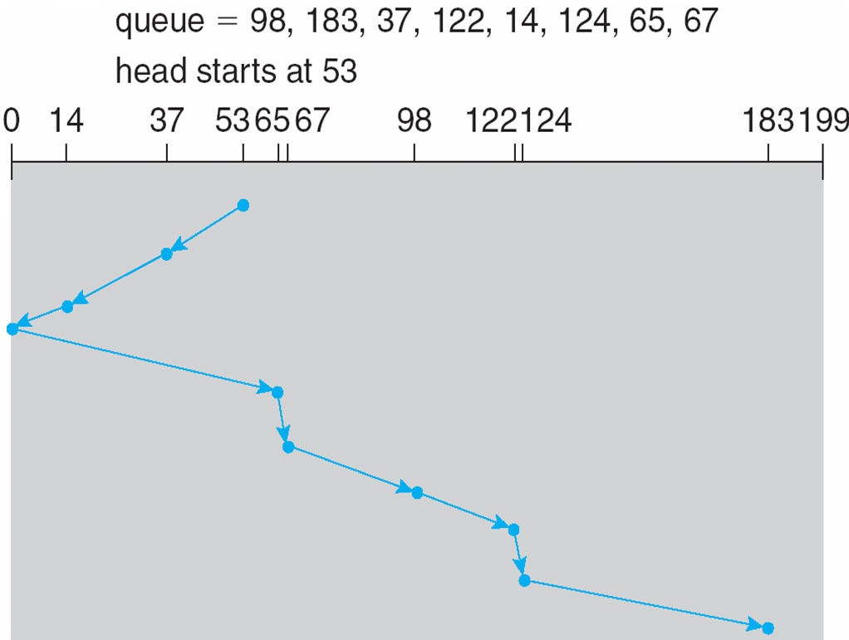
SCAN (Cont.)
Notes:
Illustration shows total head movement of 208 cylinders
做题时要先判断现在的磁头在向哪个方向移动，这里是向小柱面号方向

Slide 34
C-SCAN
Provides a more uniform wait time than SCAN
The head moves from one end of the disk to the other, servicing requests as it goes
When it reaches the other end, however, it immediately returns to the beginning of the disk, without servicing any requests on the return trip
Treats the cylinders as a circular list that wraps around from the last cylinder to the first one
Notes:
普通的SCAN问题：掉头时处理的柱面请求很少，因为刚刚处理过，而另一端的请求会积攒较多，还要等待disk head一个来回。导致每个煮面的等待时间不均匀。
这个算法直接跳转到另一端，总是往一个方向扫描

Slide 35
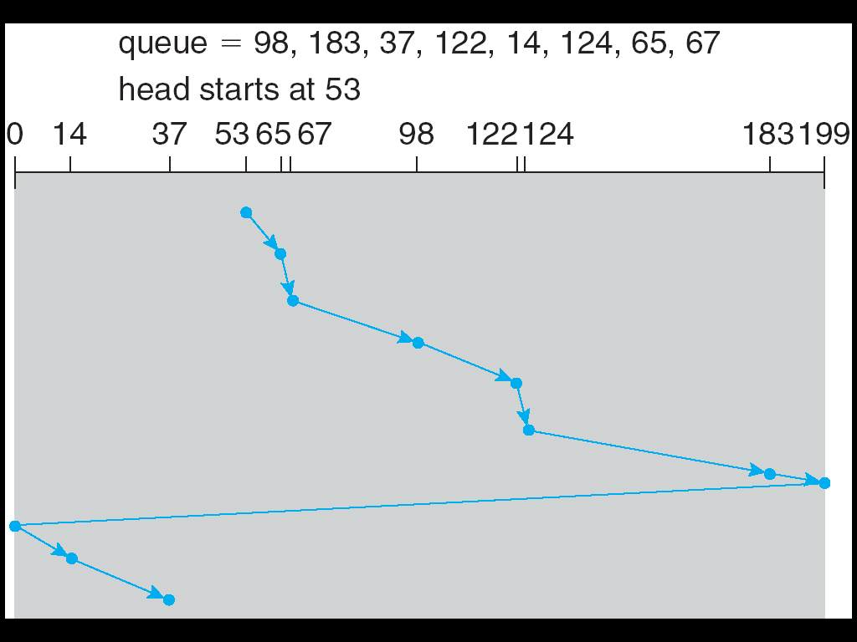
C-SCAN (Cont.)
Notes:
What is the total seek distance?

Slide 36
Look & C-LOOK
LOOK a version of SCAN, C-LOOK a version of C-SCAN
Arm only goes as far as the last request in each direction, then reverses direction immediately, without first going all the way to the end of the disk
处理完等待队列中最大或最小柱面的请求就调头，节约时间

Slide 37
LOOK

Slide 38
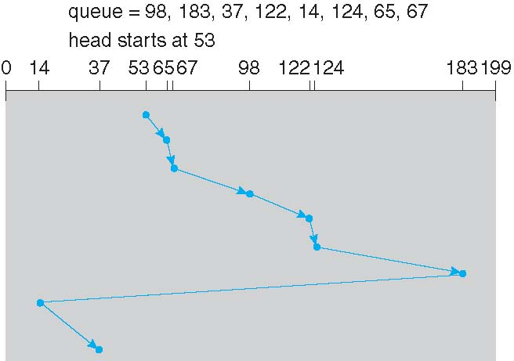
C-LOOK (Cont.)
Notes:
What is the total seek distance?

Slide 39
SSD Scheduling?
NOOP
Notes:
https://forum.huawei.com/enterprise/zh/thread/580935617976614912

Slide 40
RAID

Slide 41
RAID Structure
RAID – redundant array of inexpensive (independent) disks
multiple disk drives provides reliability via redundancy
improvement performance by the use of multiple disks working cooperatively
Techniques
Stripping
Mirroring
Error correcting

Slide 42
RAID Levels

Slide 43
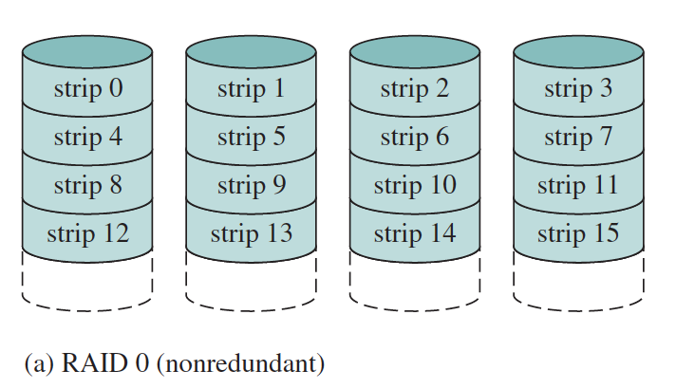
RAID 0: stripping (bit/block level)
Notes:
理论读写速度是单盘读写速度的X倍，X指加入到同一阵列的磁盘数。同时容量也为单盘容量的X倍。

Slide 44
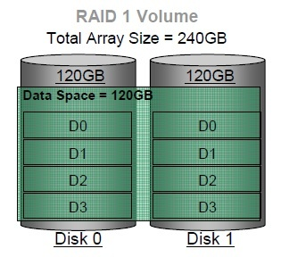
RAID 1: mirroring
Notes:
读写速度与单盘相同，容量为单盘的容量。
当原始数据繁忙时，可直接从镜像备份中读取数据，因此RAID1可以提供读取性能。

Slide 45
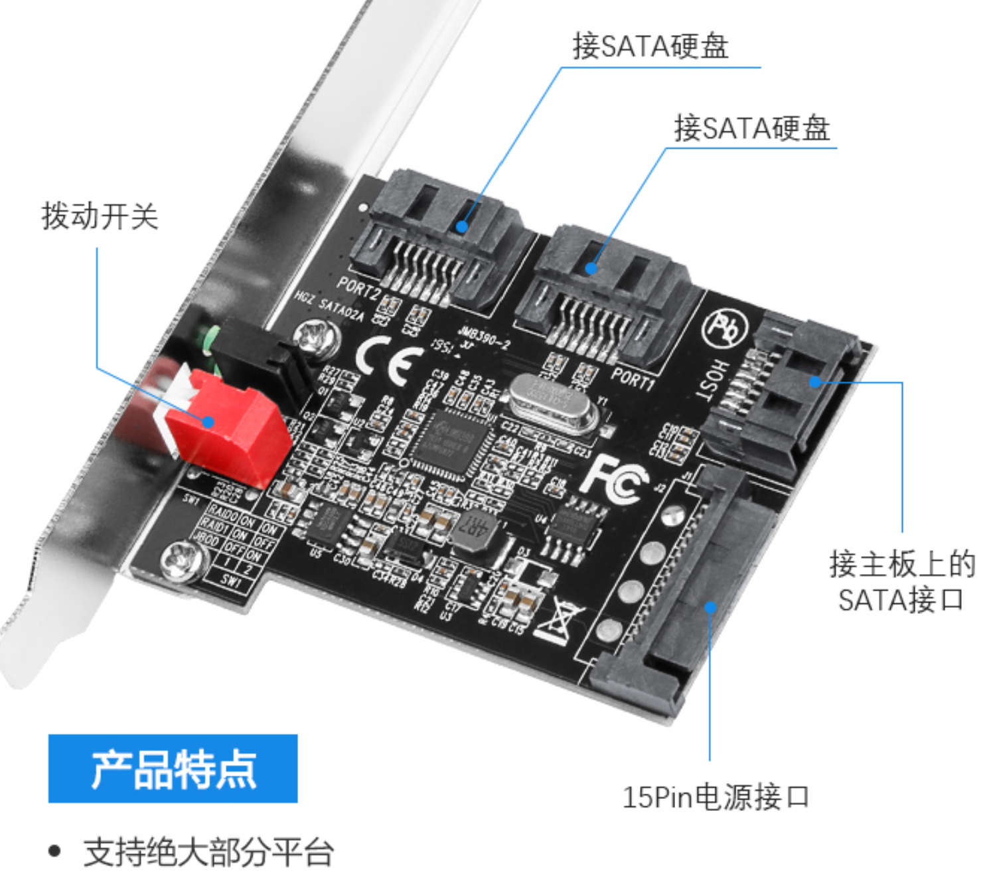
RAID Card
Notes:
139 yuan; 开关拨动raid0， raid1

Slide 46
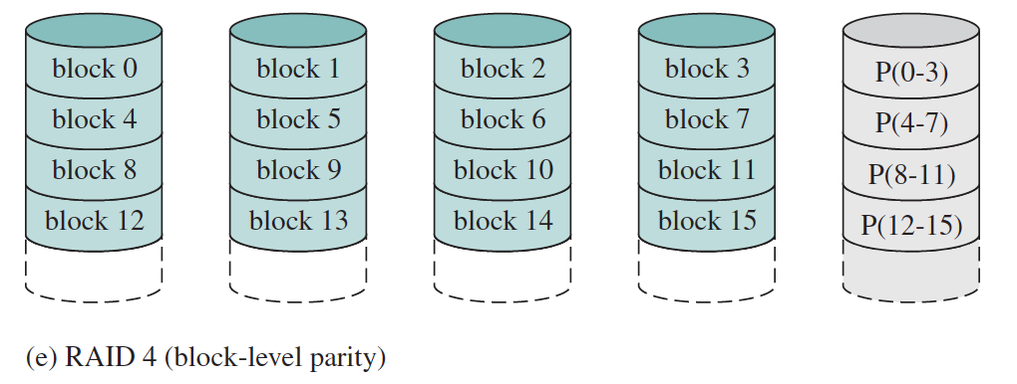
RAID 4
Notes:
奇偶校验码通常所说的奇偶校验码指的是一维奇偶校验码，它只能检错，不能纠错；只有二维奇偶校验码具备纠错能力。校验方法：分为奇校验和偶校验，默认是校验所传输数据中’1’的个数是奇数还是偶数。当约定为奇校验时，当所传输数据中’1’的个数为奇数，便在数据后面添加’0’；当所传输数据中’1’的个数为偶数，便在数据后面添加’1’，使1的个数满足奇数个。当约定为偶校验时，类似。后面的附加位选择是用来控制数据中’1’的个数，使其满足校验规则（奇数个或是偶数个）。
For every bit in the block, we can determine if it is a 1 or a 0
by computing the parity of the corresponding bits from sectors in the other
drives. If the parity of the remaining bits is equal to the stored parity, the
missing bit is 0; otherwise, it is 1.

Slide 47
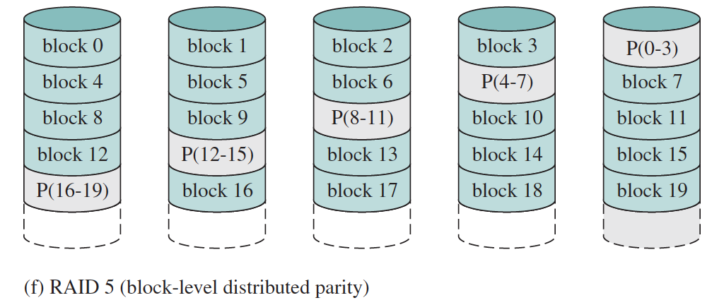
RAID 5
Notes:
奇校验：一个字节8位（此处是4位）中“1”的个数，校验位，添加一位，使9位（5位）中“1”的个数为奇数；偶校验同理。奇校验：就是让原有数据序列中（包括你要加上的一位）1的个数为奇数10001100（0）你必须添0，这样原来有3个1，已经是奇数了，所以你添上0之后，1的个数还是奇数个。偶校验：就是让原有数据序列中（包括你要加上的一位）1的个数为偶数10001100（1）你就必须加1了，这样原来有3个1，要想1的个数为偶数，就只能添1了。校验的原理是：假如采用奇校验，发送端发送的一个字符编码（含校验位）中，“1”的个数一定为奇数个，在 接收端对接收字符二进制位中的“1”的个数进行统计，若统计出“1”的个数为偶数个，则意味着传输过程中有1位（或奇数位）发生差错。
奇偶校验码的作用只是能够检测数据是否出现错误，同时也有一定的限制。首先，当数据位有两个错误时，奇偶校验就不再起作用了。比如，数据为11011001，若中途由于错误发生了两次数字的翻转，最终的奇偶校验结果将仍为1，但实际上数据已经发生了错误。其次，奇偶校验不能检测出位数不够的错误。比如，数据为10011001，数据传输过程中丢失了一个数字，虽然奇偶校验码仍然会检测到该数据没有校验通过，但无法确定丢失的数字是哪个。

Slide 48
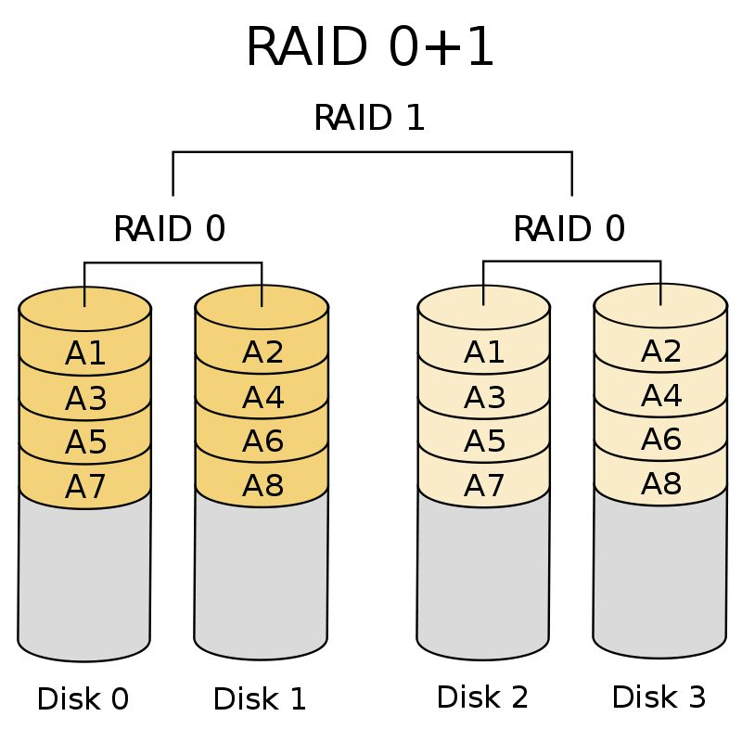
RAID (0 + 1)
Notes:
Both reliability and performance
Which is more reliable?

Slide 49
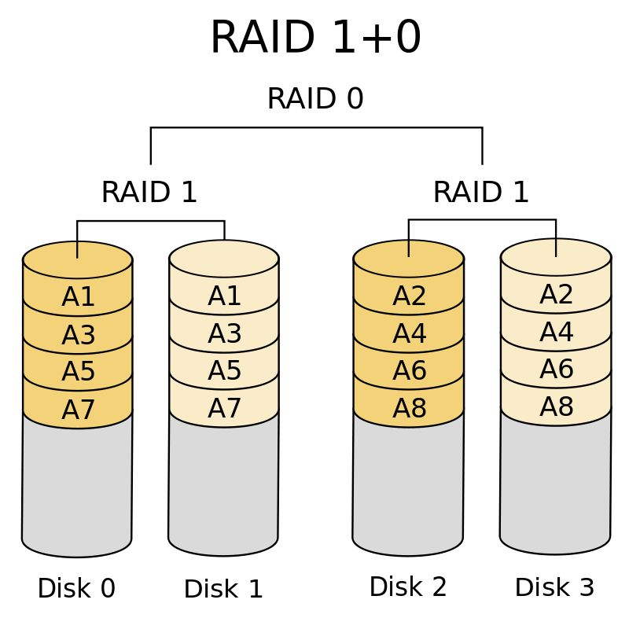
RAID (1 + 0)
Notes:
Both reliability and performance
Raid10 has better reliability？
可以用坏掉两块硬盘为例来证明一下：1/3的概率和2/3的概率

Slide 50
End of Chapter 12

Slide 51
Chapter 10: File System Interface

Slide 52
Chapter 10: File System
Files
Directories
Access Control & Protection

Slide 53
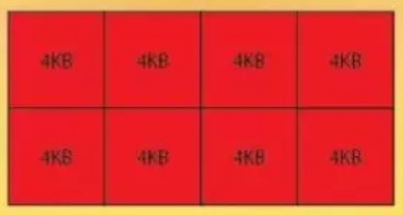
Review
Disk
Physical storage unit
Logical block address： LBA
0 | 1 | 2 | 3 | …

Slide 54
Files

Slide 55
File Concept
Contiguous logical address space
010110101110000101100101001001…

Slide 56
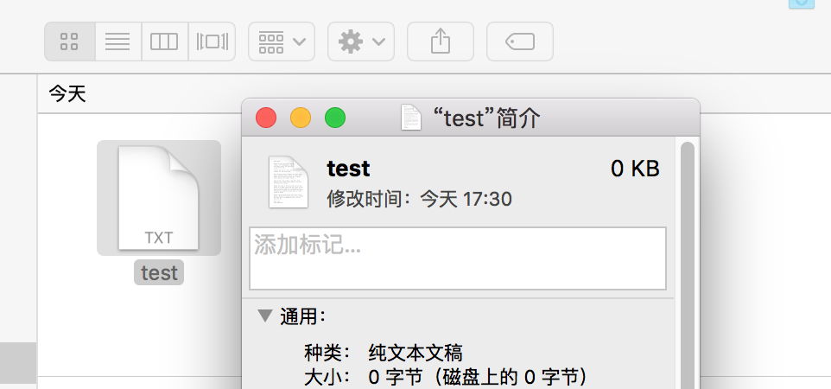
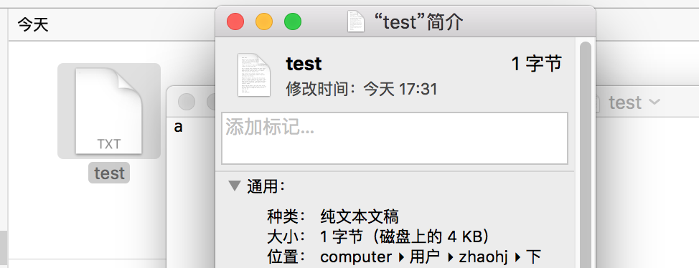
File Block
Notes:
磁盘上的4KB，因为磁盘上也是按块开辟空间，比如SSD就是page，一个page一般就是4KB

Slide 57
File Mapping
Disk (LBA)
File
File block
Internal fragmentation
Notes:
sudo blockdev --getpbsz /dev/sda
//physical sector size: hdd drive
//sudo blockdev --getss /dev/sda (logical sector size: kernel)
sudo blockdev --getbsz /dev/sda
block size: file system
cat /sys/block/sda/queue/physical_block_size (physical sector size: hdd drive)
cat /sys/block/sda/queue/logical_block_size (physical sector size: hdd drive)
sudo fdisk -l (logcial and physical sectors)
sudo tune2fs -l /dev/sda1 (block size: file system)

Slide 58
File Attributes(Meta-data)
Name – only information kept in human-readable form
Identifier – unique tag (number) identifies file within file system
Type – needed for systems that support different types
Location – pointer to file location on device
Size – current file size
Protection – controls who can do reading, writing, executing
Time, date, and user identification – data for protection, security, and usage monitoring
Meta-data
Notes:
ls -i

Slide 59
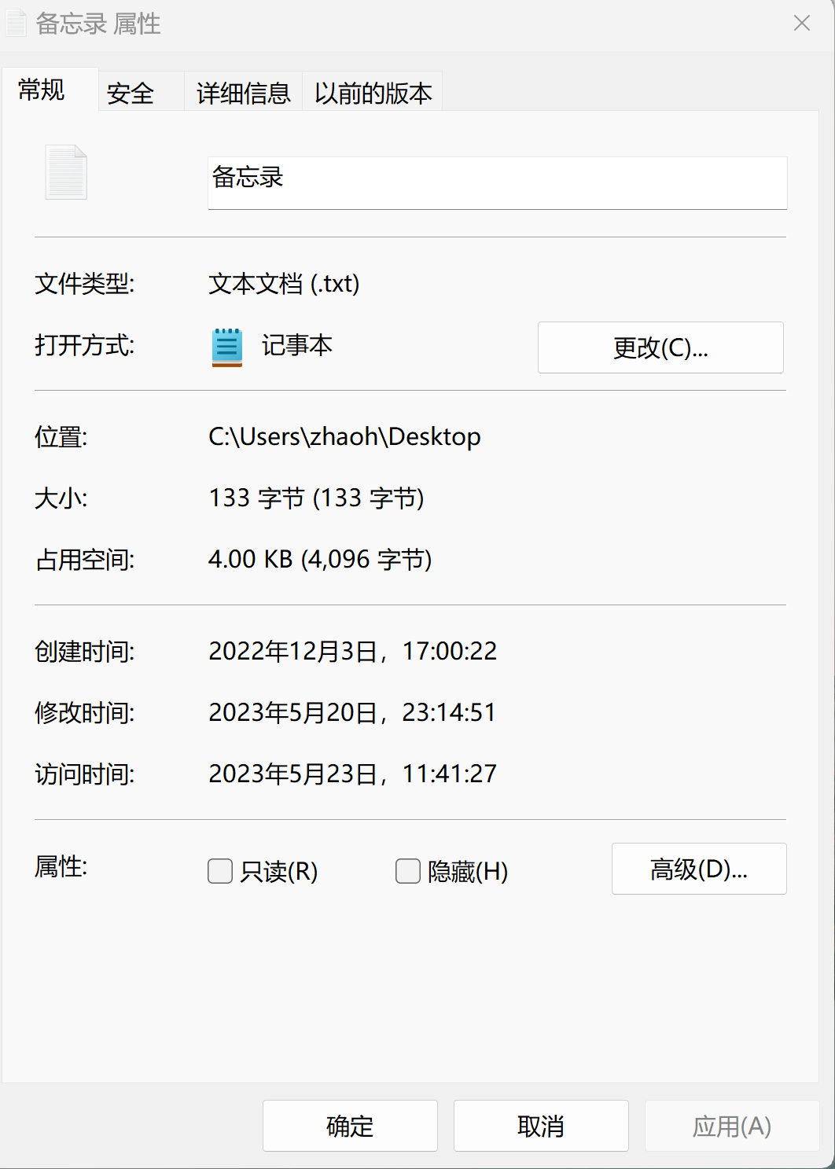
File info Window on Mac OS X

Slide 60
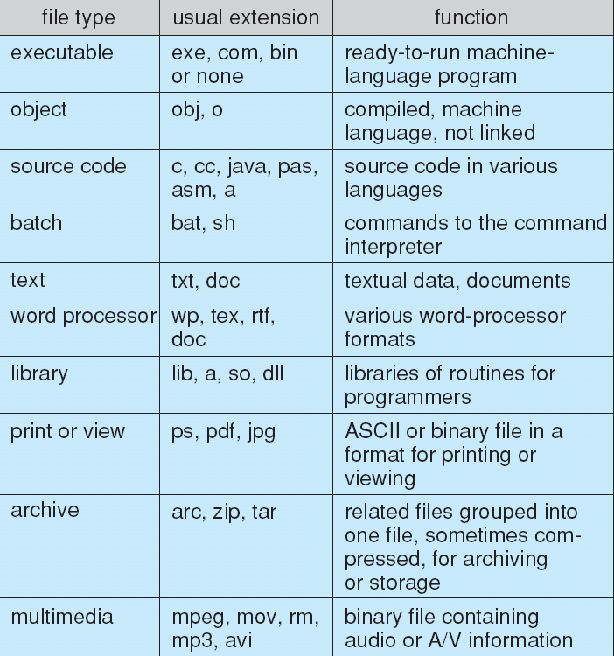
File Types – Name, Extension
A hint
Notes:
Rename a .docx file but it can still be opened
But for gcc

Slide 61
File Structure
None - sequence of words, bytes
Character
Binary
Simple record structure
Lines
Fixed length
Variable length
Complex Structures
Formatted document
Relocatable load file
Who decides:
Operating system
Program

Slide 62
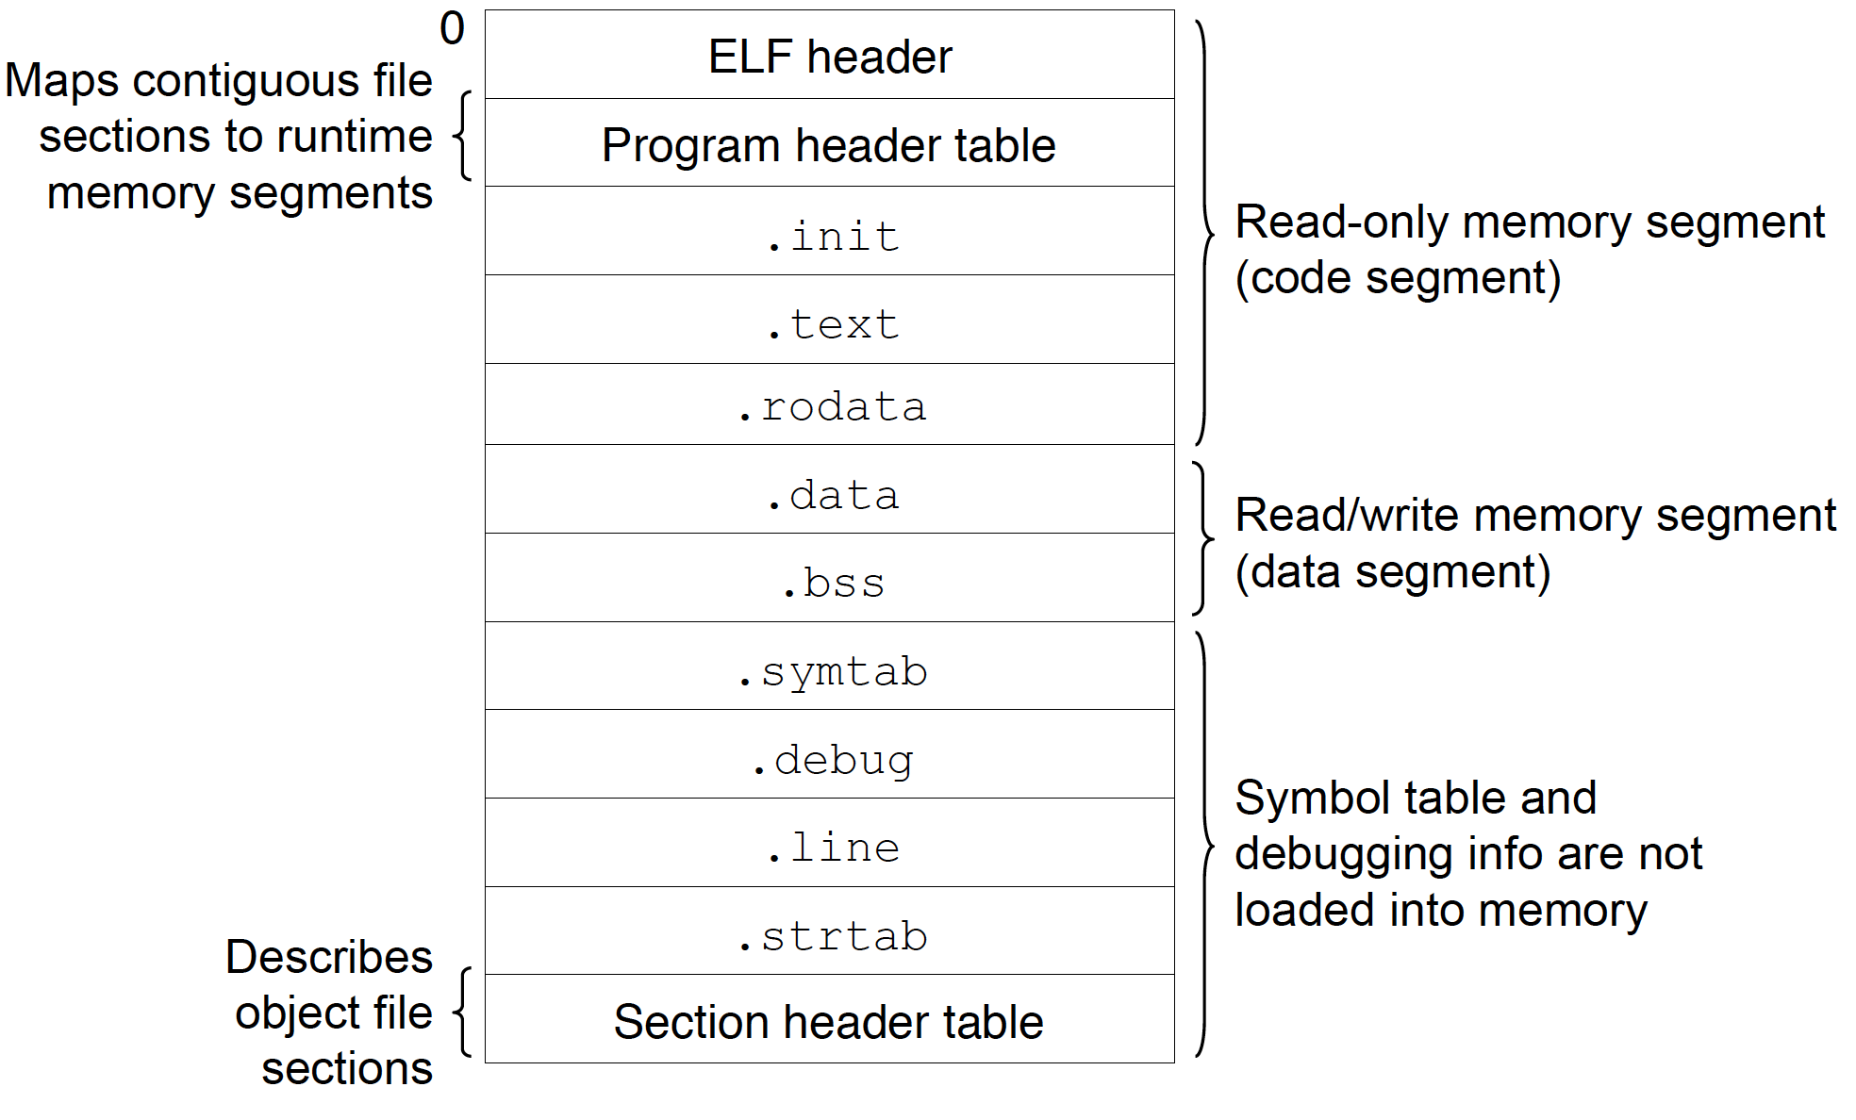
Program on disk
Notes:
a.out from linux to mac

Slide 63
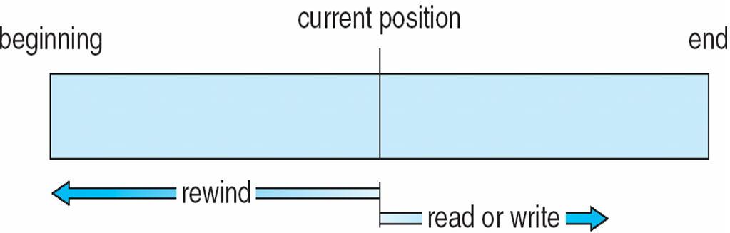

File Access: Sequential（顺序访问）
倒回
read_next()
write_next()
Notes:
Tape?
Read_next()
Write_next()

Slide 64
File Access: Direct
Direct Access – file is fixed length logical records
read(n)（n是块号）
write(n)
position_to(n)
n = relative block number
block size: 100
disk
file size: 178
file
Notes:
或者叫做相对访问，而已按照任意的顺序读写。
用户提供相对块号，也就是只针对这个文件的相对块号，0123456…
绝对块号并非如此。
比如要访问的n=1，block size=100，那就要从第101个字节开始访问，访问完这个块的100个字节

Slide 65
File Operations
Create
Delete
Open
Close
Read – at read pointer location
Write – at write pointer location
Reposition within file – seek

Slide 66
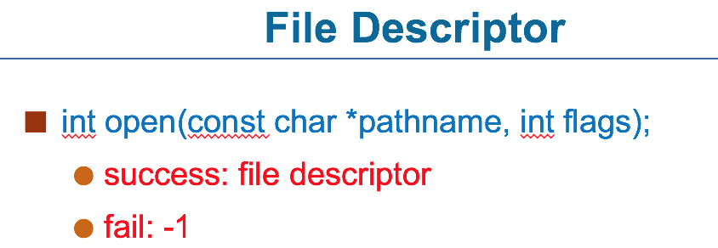
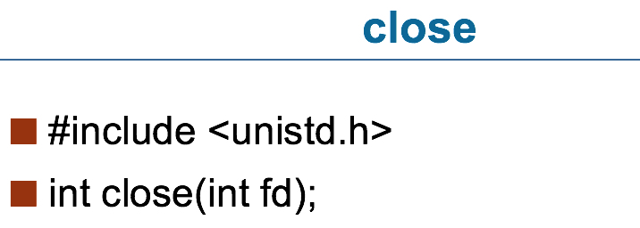
Open & Close
open(F_{i}) – search the directory structure on disk for entry F_{i}, and move the content of entry to memory
close(F_{i}) – move the content of entry F_{i} in memory to directory structure on disk
Notes:
每个文件都有自己的file descriptor，是索引号

Slide 67
Open Files
Several pieces of data are needed to manage open files:
Open-file table: tracks open files
File pointer: pointer to last read/write location, per process that has the file open
File-open count: counter of number of times a file is open – to allow removal of data from open-file table when last processes closes it
Disk location of the file: cache of data access information
Access rights: per-process access mode information
Notes:
Access right: read or write

Slide 68
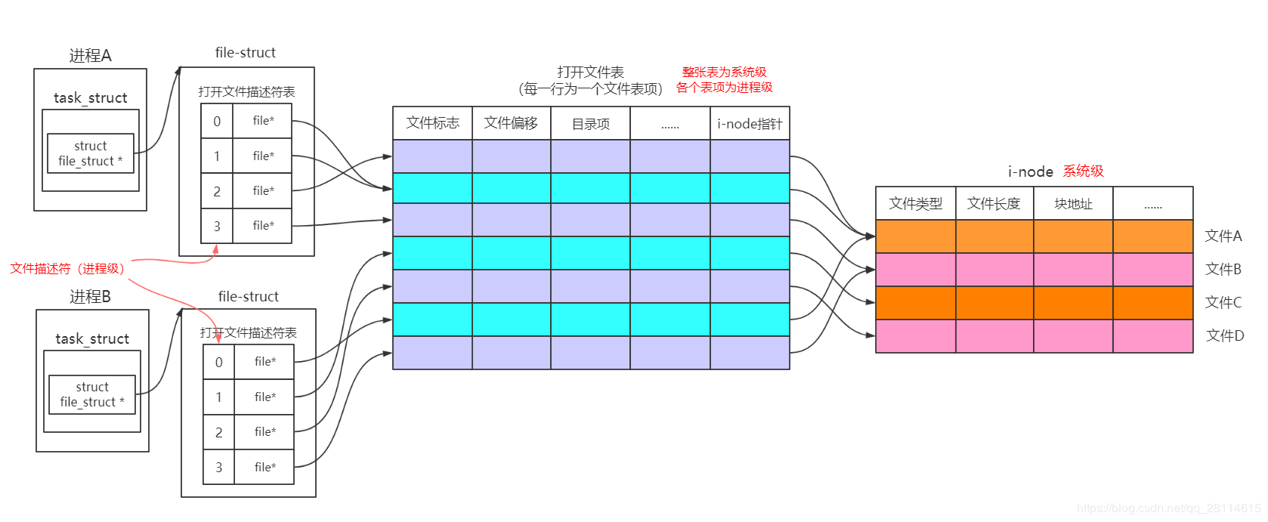
Open Files
System
open file table
Per-process open file table
Notes:
每个进程都有自己的open file table，里面有file descriptor对应文件信息，然后通过文件信息中的identifier找到system open file table，整张表是系统级的，而里面的各个表项为各个进程维护的。

Slide 69
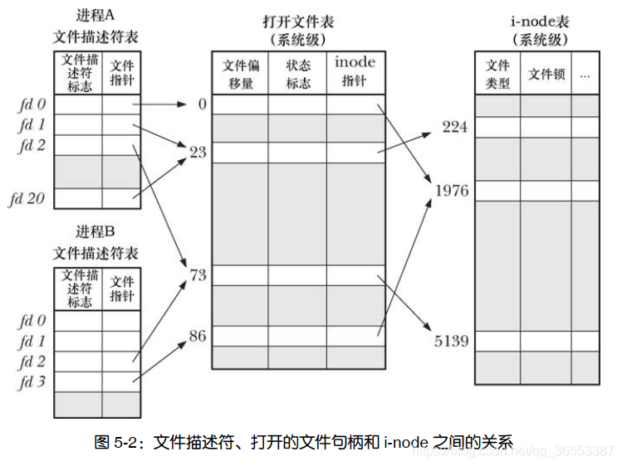
Open Files
Notes:
https://blog.csdn.net/qq_36553387/article/details/118703354
图展示了文件描述符，打开的文件句柄以及i-node之间的关系。在图中，两个进程拥有诸多打开的文件描述符。在进程A中，文件描述符1和20都指向同一个打开的文件句柄（标号为23）.这可能是通过调用dup(),dup2()或fcntl()形成的。进程A的描述符2和进程B的文件描述符2都指向同一个打开的文件句柄（标号为73）。这种情形可能是在调用fork后出现（即，进程A和进程B之间是父子关系），或者当某进程通过UNIX域套接字将一个打开的文件描述符传递给另一进程时，也会发生。此外，进程A的描述符0和进程B的描述符3分别指向不同的打开文件句柄，但这些句柄均指向i-node表中的相同条目（1976），换言之，指向同一文件。发生这种情况是因为每个进程各自对同一文件发起了open()调用。同一个进程两次打开同一文件，也会发生类似情况。上述讨论揭示出如下要点：两个不同的文件描述符。若指向同一打开文件句柄，将共享同一文件偏移量。因此，如果通过其中之一文件描述符来修改文件偏移量（由调用read(),write(),lseek()所致），那么从另一文件描述符也会观察到这一变化。无论这两个文件描述符分属于不同进程，还是同属于一个进程，情况都是如此。要获取和修改打开的文件标志（例如，O_APPEND,O_NONBLOCK,O_ASYNC），可执行fcntl()的F_GETFL和F_SETFL操作，其对作用域的约束与上一条类似。文件描述符标志为进程和文件描述符所私有。对这一标志的修改不会影响到同一进程或不同进程中的其他文件描述符。

Slide 70
Directories（目录）

Slide 71
Recall File Block
0 size file
Where is the meta data stored?

Slide 72
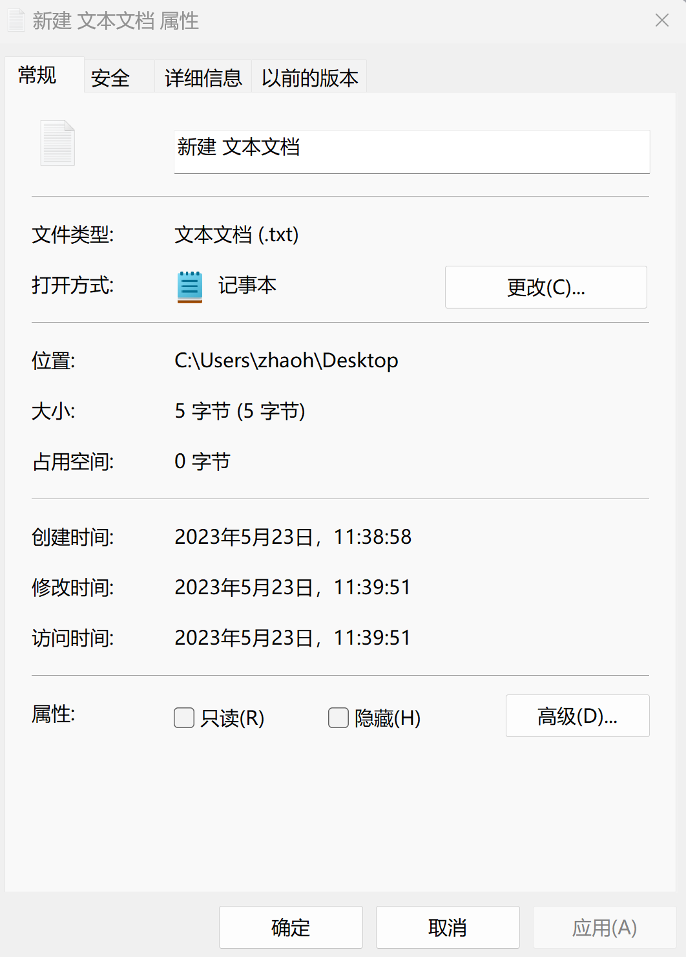
Recall File Block
Notes:
Nsfc的目录用来存放小文件

Slide 73
File Attributes
Name – only information kept in human-readable form
Identifier – unique tag (number) identifies file within file system
Type – needed for systems that support different types
Location – pointer to file location on device
Size – current file size
Protection – controls who can do reading, writing, executing
Time, date, and user identification – data for protection, security, and usage monitoring
Meta-data kept in the directory structure!
Notes:
元数据都在目录中

Slide 74
Directory Structure
A collection of nodes containing information about
all files
Directory
Meta data
Files
F 1
F 2
F 3
F 4
F n
Both the directory structure and the files reside on disk
Notes:
目录中有指向文件的指针

Slide 75
Meta-data保存在设备目录中，设备目录包含了卷上所有文件的信息。
目录是一个特殊文件，也在磁盘上
目录类似一个表格，每一行对应文件的meta data，即使文件占有磁盘空间为0，他也在目录中，只是指针为空指针
磁盘可以划分为多个分区（partition），包含file system的分区称为卷（volume），一个卷可以是设备的一部分，可以是整个设备，可以是多个设备。

Slide 76
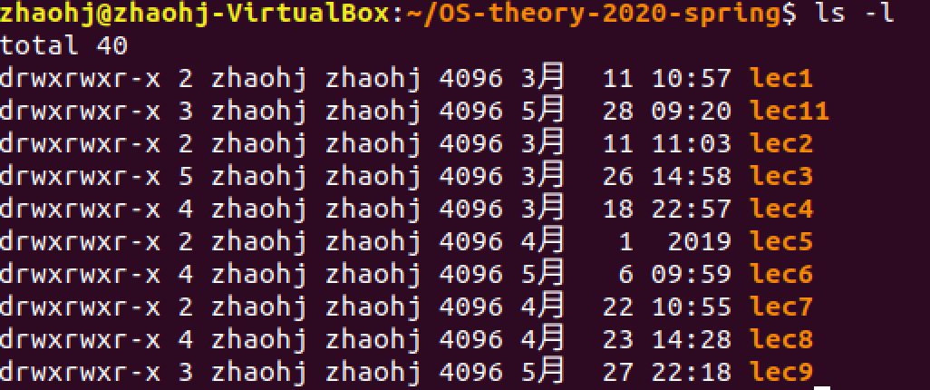
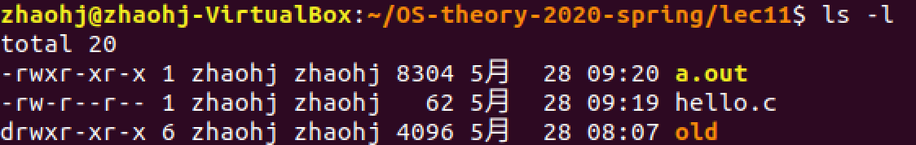
Directory Implementation
A file
Notes:
drwx 4096

Slide 77
Operations Performed on Directory
Create a file
Delete a file
Rename a file
Open and close a file
Search for a file
List a directory
Traverse the file system
Notes:
Copy, Move

Slide 78
Organize the Directory (Logically) to Obtain
Efficiency – locating a file quickly
Naming – convenient to users
Two users can have same name for different files
Grouping – logical grouping of files by properties
e.g., all Java programs, all games, …

Slide 79
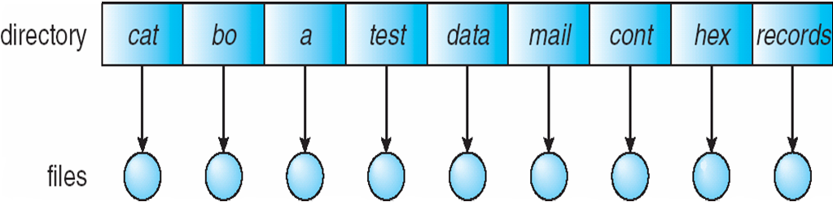
Single-Level Directory
A single directory for all users
Naming problem
Demo： getconf NAME_MAX [pathname]

Slide 80
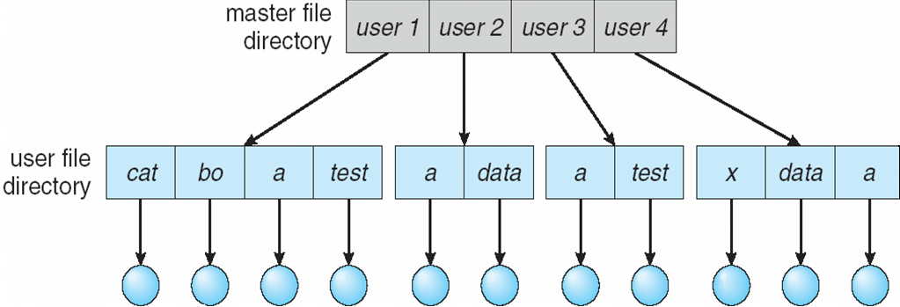
Two-Level Directory
Separate directory for each user
Path name: user+file
Can have the same file name for different user
Efficient searching
No grouping capability; No sharing and cooperation

Slide 81
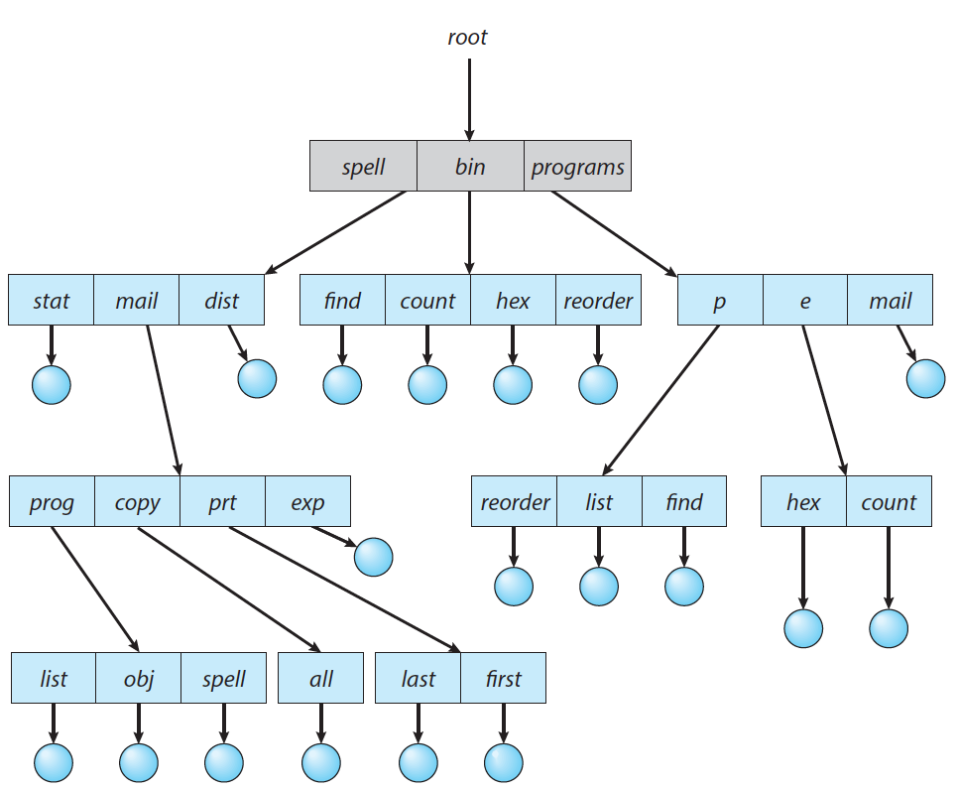
Tree-Structured Directories
Notes:
tree command in linux

Slide 82
Tree-Structured Directories (Cont.)
Efficient searching
find [path] -name [file]
Grouping Capability

Slide 83
Tree-Structured Directories (Cont)
Current directory (working directory)
Absolute or relative path name
/spell/mail/prt/first

Slide 84
Tree-Structured Directories (Cont)
Example: if in current directory /mail
mkdir count
mail
prog
copy
prt
exp
count
Deleting “mail” ⇒ deleting the entire subtree rooted by “mail”（删除整个subtree）
Notes:
rm -r: recursively

Slide 85
Protection

Slide 86
Protection
File owner/creator should be able to control:
what can be done
by whom
Types of access
Read
Write
Execute
Delete
List
Attribute change

Slide 87
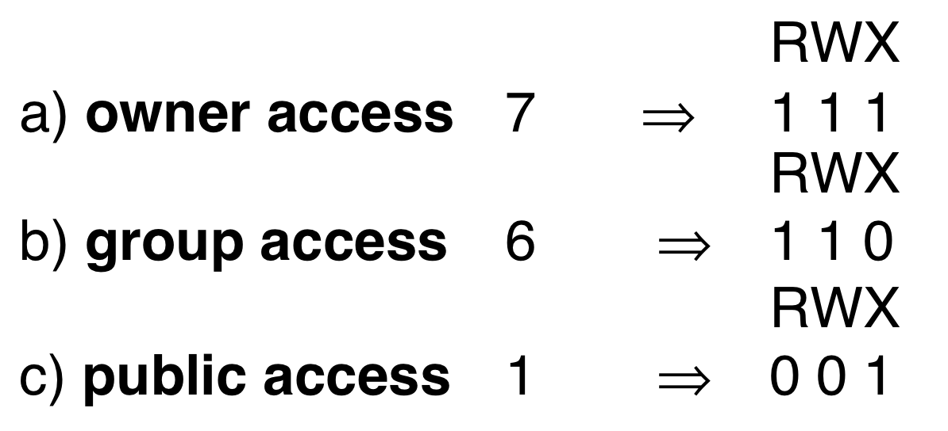
Access Lists and Groups
Mode of access: Read, Write, eXecute
Three classes of users on Unix / Linux
Owner就是文件的所有者
Group就是文件所有者所在的group
Public就顾名思义
Notes:
给每个文件都标定了针对各类用户的权限
Owner就是文件的所有者
Group就是文件所有者所在的group
Public就顾名思义

Slide 88
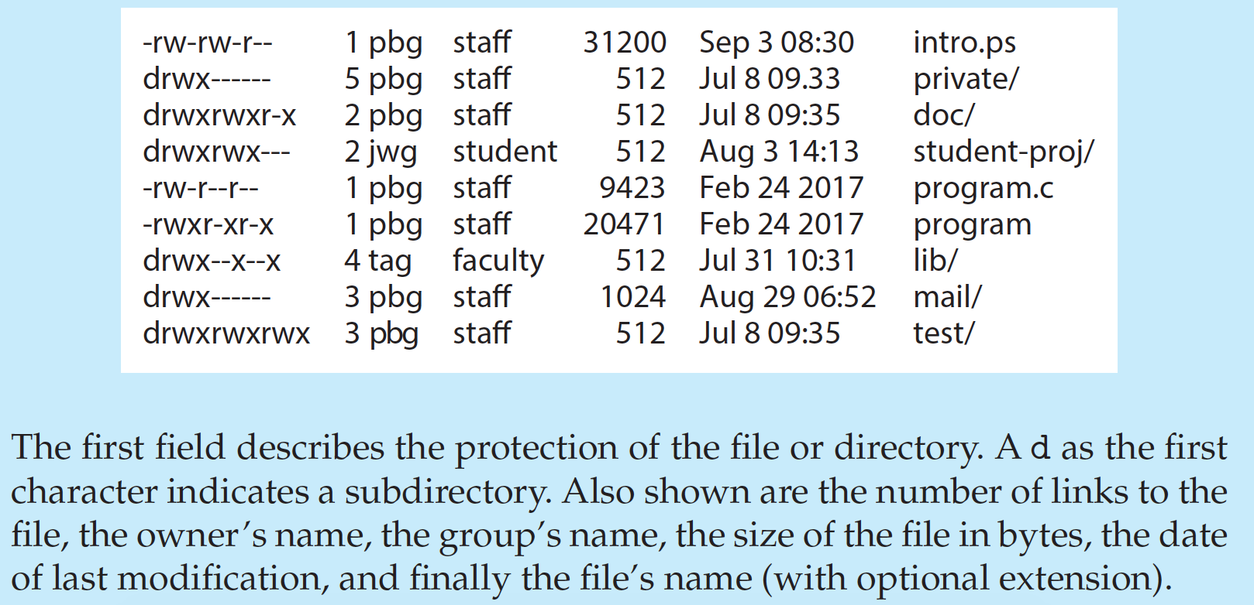
A Sample UNIX Directory Listing
Notes:
sudo chgrp guest {filename}
查看file
sudo usermod -a -G guest zhaohj
sudo groups
查看file
gpasswd -d zhaohj guest

Slide 89
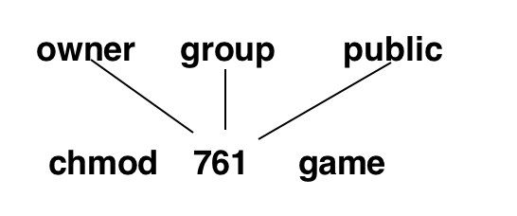
Access Lists and Groups
Ask manager to create a group (unique name), say G, and add some users to the group.
For a particular file (say game) or subdirectory, define an appropriate access.
chmod: change file mode bits
Notes:
chown xiaoming abc：改变abc的所有者为xiaoming
chgrp root abc：改变abc所属的组为root
chown root ./abc：改变abc这个目录的所有者是root
chown ‐R root ./abc：改变abc这个目录及其下面所有的文件和目录的所有者是root
sudo groupadd guest
sudo chgrp guest filename
sudo chmod 770 finename
usermod ‐g 组名 用户名
usermod -a -G apache cnzhx
useradd -G {group-name} username
useradd usertemp
groups
groups zhaohj

Slide 90
File Locking
Provided by some operating systems and file systems
Similar to reader-writer locks（类似于reader writer同步问题）
Shared lock similar to reader lock – several processes can acquire concurrently
Exclusive lock similar to writer lock
Mandatory or advisory:
Mandatory – access is denied depending on locks held and requested
Advisory – processes can find status of locks and decide what to do
Notes:
Parallel processes open the same file
Give examples: flock

Slide 91
End of Chapter 10

Slide 92
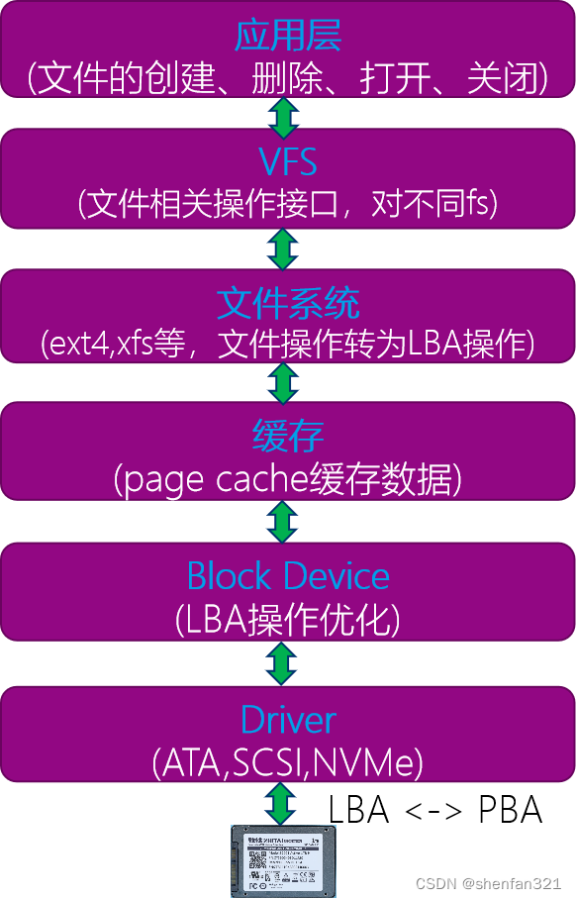
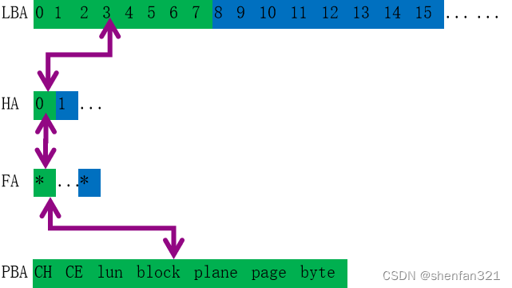
Notes:
https://blog.csdn.net/shenfan321/article/details/130069386
在HDD时代，数据可以覆盖写，LBA和PBA直接对应不会更改。但是SSD时代，由于NAND特性，LBA所对应的PBA映射关系是不断修改着的。为了向前兼容，LBA是以sector(512B)为单位顺序排列，LBA不能直接映射到PBA，需要通过中间的转换HA<->FA找到PBA。LBA计算出HA，HA根据映射表找到FA，FA根据位置计算出PBA。LBA Addr，这里根据 容量/512B 计算出sector数量。按顺序依次是0 ~n-1，每8个(4k)捆一起依次计算HA位置。HA(Host Addr)，4Bytes hpage。这里我画的比较简单，实际上hpage有按照行列规律分为segmt和block。FA(Flash Addr)，4Bytes。根据容量不同CH/CE/Plane/block/page个数不同在4Byte中的位置分布也可能不一样。比如CH 4个只需要2个bit，8 channel就需要3个bit，16channel要4个bit。PBA Addr，就是FA中的值表示的真实地址。

